Slide 1

Newberry County Coroner’s Office
2020-year END review

Slide 2
Newberry County Coroners Office
Mission statement
To serve the citizens of Newberry County with professionalism and integrity, while upholding the commitment to determine the cause and manner of death in a dignified manner and maintain respect for the families

Slide 3
Message to Newberry County Council and Citizens of Newberry County
Information collected during the investigation helps clarify the circumstances, such as the sequence of events prior to death. Evidence collected during an investigation and/or postmortem examination may help lead to the arrest or successful conviction of a suspect in a homicide case. Because deaths occur around the clock, coroner's office staff members are available 24 hours a day, 365 days per year.

Slide 4
With the skill and experience of the Coroner’s investigators and board-certified forensic pathologists, we believe the quality of death investigations in Newberry County are among the best in the State. The death scene investigation reports filed by the investigators are very thorough and supply comprehensive information to the forensic pathologist, law enforcement, DSS, SLED, LLR, and various other entities.
Our investigators also extend their duties to the living by answering questions and addressing concerns regarding deaths within the county. Coroner investigators are in personal contact with family members of a deceased and assist them by providing appropriate answers regarding the circumstances of the death. Coroner investigators are supplied with a pamphlet for distribution to families. The information provides answers to common questions and facts about autopsies and provides resource information pertaining to grief counseling.

Slide 5
In 2020 our office contributed significant input toward the implementation of a web-based death investigation report system. After aiding Occupational Research and Assessment, Inc. of Big Rapids, Michigan, the Medicolegal Death Investigation Log or MDI Log was launched in June of 2008. MDI Log is a comprehensive investigative report/database system that enables our office to review death scene investigation information from a secure Internet site any time of the day.
MDI Log enables us to submit death scene investigation reports via the Internet in an efficient manner. MDI Log has evolved to become a valuable tool for our office, and it is now available to medical examiner offices across the country.
I along with my staff, extend our sincere gratitude to the Newberry County Council for their support of the Coroners and the services we provide to the citizens of the Newberry County.

Slide 6
Duties of the Coroner
Investigates sudden, violent, unexpected, and suspicious deaths
Charged with making positive identification of decedents either through interviews, investigation, and forensics.
Determine the cause and manner of death
Make family notifications
Certify death after an investigation and/or postmortem examination as required by law.
Report and distributed the findings of that death to families, law enforcement agencies and other agencies as appropriate.
Issue cremation permits

Slide 7
Chain of Command
Coroner
(Full-time position)
Laura Kneece, F-ABMDI, MPA
Chief Deputy Coroner
(Non-classified Position)
Deputy Coroner
(Non-classified position)
Kevin Worley
Madison Cates

Slide 8
Cause and Manner of Death
Cause
Manner
Cause of death is the disease process or injury that resulted in death.
Disease process:
Cardiomegaly
COPD
Renal Failure
Injury:
Exsanguination due to GSW to torso
Manner of death is a classification in which a determination a whether the death resulted by:
  Natural causes,
  Homicide,
  Suicide,
  Accident.
  On occasion, undetermined.

Slide 9
Types of Deaths Reportable to the Coroner’s Office
SC SECTION 17‑5‑530. Duty to notify coroner's or medical examiner's office of certain deaths and stillbirths; inquiry; findings; notification of next‑of‑kin; consent for certain actions.
(A) If a person dies:
(1) as a result of violence;
(2) as a result of apparent suicide;
(3) when in apparent good health;
(4) when unattended by a physician;
(5) in any suspicious or unusual manner;
(6) while an inmate of a penal or correctional institution;
(7) as a result of stillbirth when unattended by a physician; or
(8) in a health care facility, as defined in Section 44‑7‑130(10) other than nursing homes,
within twenty‑four hours of entering a health care facility or within twenty‑four hours after having undergone an invasive surgical procedure at the health care facility;
a person having knowledge of the death immediately shall notify the county coroner's or medical examiner's office. This procedure also must be followed upon discovery of anatomical material suspected of being or determined to be a part of a human body.

Slide 10
Manner of death
Accident 33 (6%)
Homicide 2 (1%)
Natural 422 (92%)
Pending 1 (0%)
Suicide 7 (2)
Undetermined 1
(0%)
TOTAL 476

Slide 11
Death by Natural Causes
Neurological: | 111
Cardiac: | 91
Renal (Kidney): | 14
Pulmonary: | 35
Hepatic (Liver): | 6
Endocrine: | 3
Cancer: | 78
COVID: | 6
Other: | 16

Slide 12
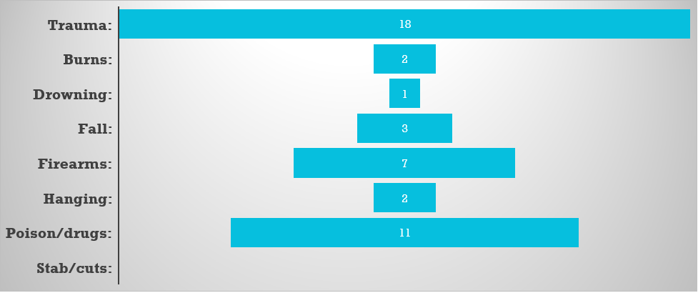
Unnatural Causes

Slide 13
Motor Vehicle Collision Deaths
Auto/SUV | 8
Motorcycle | 1
Pedestrian: | 3
Other: | 3

Slide 14
Deaths by age group:
0-1: | 4
1-5: | 0
6-10: | 0
11-17: | 3
18-25: | 4
26-44: | 31
45-64: | 82
65-100: | 337

Slide 16
Manner of Death

Slide 17
2020 Accomplishments
Digital X-ray machine and camera
Pill counter
Training
Reporting
System
Contracted with
MDI log
in order to have a more comprehensive investigative report and database system.
Westview Behavioral Center submitted a grant for the purchase of an automatic pill counter which was donated to the coroner's office.
Paul Coverdell grant submission requesting monies for a digital x-ray machine to be used by Newberry Pathology Group.
Along with three (3) newb LSR cameras with equipment.
Maintained required training hours during a pandemic.

Slide 18
2021-2024 Visions and Goals
Complete certification testing for ABMDI.
Seek provisions and requirements for expansion/advancement
of the Coroner’s Office
ie: grant and county funding for coroner/pathology suites, morgue, holding facility and family viewing area.
Increase staffing due to shortage and increased call volume.

Slide 19
2021-2024 Visions and Goals, cont.
Continue to seek the most recent and advanced training.
Provide public awareness on growing concerns in reference to COVID, opioids, etc.
Acquire equipment that will provide a safer and healthier environment for our staff,
ie: Power lifts to prevent back injuries

Slide 20
QUESTIONS and Comments

Slide 22

This Photo by Unknown Author is licensed under CC BY-ND

